Slide 1
STATISTICAL DATABASE & CHALLENGES OF DATABASE SECURITY
Sudam Sapkota
Roll no-09

Slide 2
Statistical Database

Slide 3
Statistical Database
Is a database used for statistical analysis purposes.
Contains a large number of individually sensitive records .
Contain confidential data about individuals, which should be protected from user access.
Users are permitted to retrieve statistical information about the populations, such as average, sum, count, maximum ,minimum , and standard deviation.
Is intended to supply only statistical summary information to its users, not information to some specific individual

Slide 4
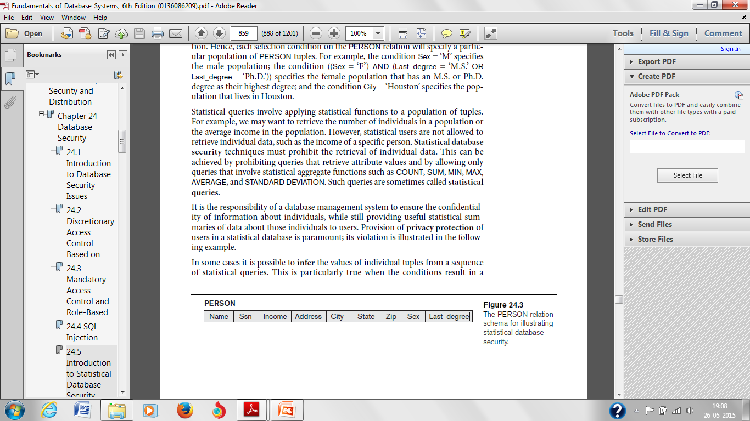
Statistical Database
A population is a set of tuples of a relation that satisfy some selection condition.
Each selection condition on the PERSON relation will specify a particular population of PERSON tuples.
PERSON
Figure: The PERSON relation schema for illustrating
statistical database security.

Slide 5
Statistical Database
Example:
Select *
From PERSON
Where Sex=‘M’;
Results: Retrieve all the information from the table PERSON who is male.
Select *
From PERSON
Where Sex=‘F’ AND last_degree=‘M.S’ or last_degree=‘Ph.D’ AND city=‘Houston’;
Results: Retrieve the information who has the following conditions specifies the female population that has an M.S. or Ph.D. degree as their highest degree and the condition specifies the population that lives in Houston.

Slide 6
Statistical database security
Statistical queries involve applying statistical functions to a population of tuples.
We may want to retrieve the number of individuals in a population or the average income in the population.
Statistical users are not allowed to retrieve individual data.(income)
Statistical database security techniques prohibit the retrieval of individual data.
Achieved by prohibiting queries that retrieve attribute values .
Allowing only queries that involve statistical aggregate functions such as COUNT, SUM, MIN, MAX,AVERAGE, and STANDARD DEVIATION.

Slide 7
Statistical database security
Queries are called statistical queries.
Responsibility of a database management system is to ensure the confidentiality of information about individuals.
Provision of privacy protection of users in a statistical database is important.

Slide 8
Challenges of Database Security

Slide 9
Challenges of Database Security
Some of the main challenges that researchers in database security are trying to address are as follows:
Data Quality
The database community needs techniques and organizational solutions to assess and attest the quality of data.
Techniques may include simple mechanisms such as quality stamps that are posted on Web sites.
We also need techniques that provide more effective integrity semantics verification and tools for the assessment of data quality.
Application-level recovery techniques are also needed for automatically repairing incorrect data.

Slide 10
Challenges of Database Security...
Intellectual Property Rights
With the widespread use of the Internet and intranets, legal and informational aspects of data are becoming major concerns of the organizations.
Watermarking techniques for relational data have been proposed.
The main purpose of digital watermarking is to protect content from unauthorized duplication and distribution by enabling provable ownership of the content.
Research is needed to assess the robustness of such techniques and to investigate different approaches aimed at preventing intellectual property rights violations.

Slide 11
Challenges of Database Security...
Database Survivability
Database systems need to operate and continue their functions, even with reduced capabilities, despite disruptive events such as information warfare attacks.
To prevent an attack and detecting one in the event of occurrence, should be able to do the following:
Confinement: Take immediate action to eliminate the attacker’s access to the system and to isolate or contain the problem to prevent further spread.
Damage assessment: Determine the extent of the problem, including failed functions and corrupted data.
Reconfiguration: Reconfigure to allow operation to continue in a degraded mode while recovery proceeds.
Repair: Recover corrupted or lost data and repair or reinstall failed system functions to re-establish a normal level of operation.
Fault treatment: To the extent possible, identify the weaknesses exploited in the attack and take steps to prevent a recurrence.

Slide 12
References
Fundamentals of Database Systems fifth Edition-Ramez Elmasri,Shamkant B.Navathe.
http://www.collegelib.com/t-database-security-issues-and-challenges.html
http://www.readorrefer.in/article/Challenges-of-Database-Security_11587/
http://www.kprblog.in/cse/sem3/statistical-database-in-dbms/

Slide 13
Thank you

